Slide 1
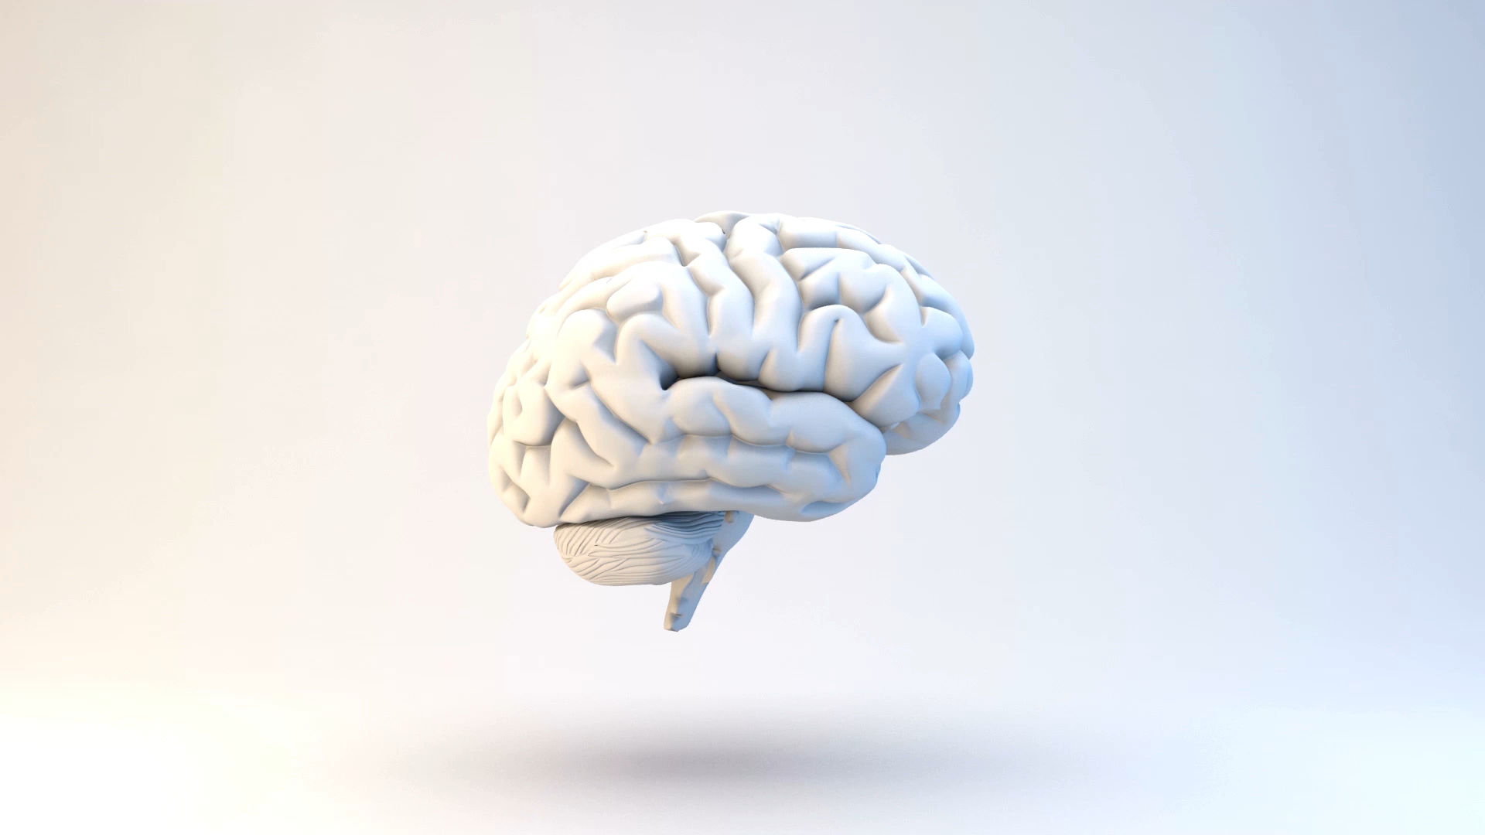
Algorithm Club: ImageNet Classification with Deep Convolutional Neural Networks (Krizhevsky et al., 2012). & Visualizing and Understanding Convolutional Networks

Slide 2
Starting with ImageNet Classification with Deep Convolutional Neural Networks (Krizhevsky et al., 2012).

Slide 3
Introduction
To learn about thousands of objects from millions of images, we need a model with a large learning capacity. Deep networks required.
Deep networks prohibitively expensive to apply in large scale to high-resolution images. (2012 hardware and software)
CNNs make strong and mostly correct assumptions about the nature of images, therefore easier to train vs feedforward neural networks (fewer connections and parameters).
High power GPUs (2012) + optimized convolution facilitate large/deep CNNs training on large datasets (ImageNet) without severe overfitting.

Slide 4
Paper contributions
Trained one of the largest convolutional neural networks to date on the subsets of ImageNet (2012)
Achieved by far the best results ever reported on these datasets.
Wrote a highly-optimized GPU implementation of 2D convolution.
Used existing techniques to avoid overfitting in large networks (Drop out).

Slide 5
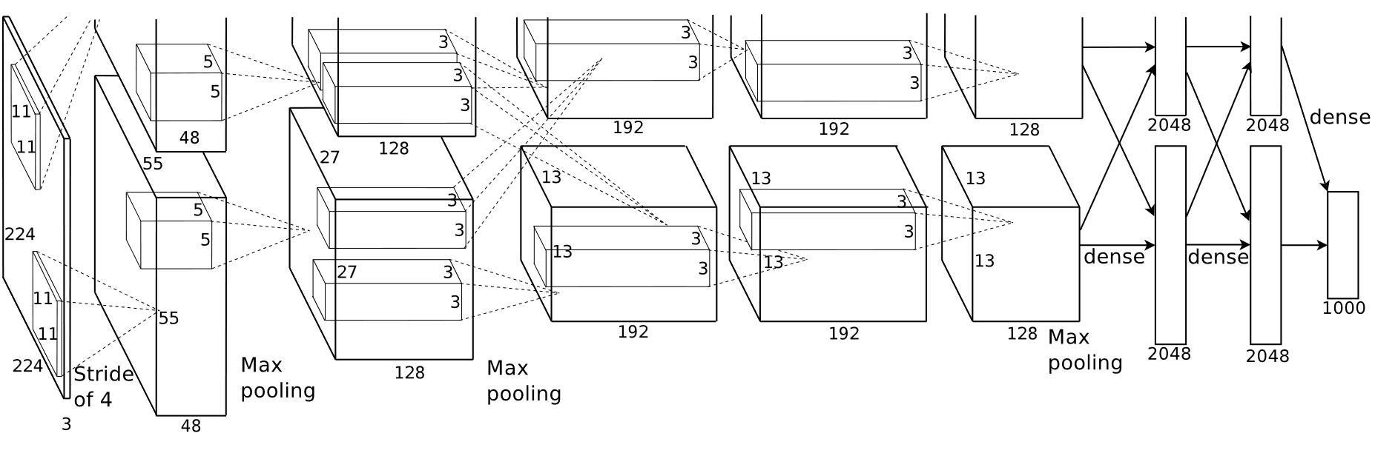
The Model
The net contains eight layers with weights; the first five are convolutional and the remaining three are fully connected.
The network’s input is 150,528-dimensional, and the number of neurons in the network’s remaining layers is given by 253,440–186,624–64,896–64,896–43,264–4096–4096–1000.

Slide 6
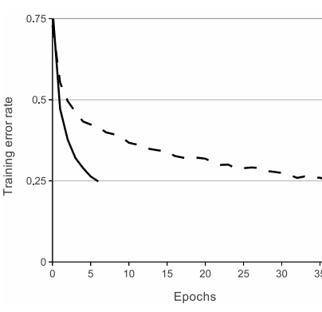
The Model: ReLU vs tanh
ReLU: solid line
tanh: dashed line
25% training error rate on CIFAR-10 six times faster.
Faster learning has a great influence on the performance of large models trained on large datasets.
They would not have been able to experiment with such large neural networks if they used traditional saturating neuron models.

Slide 7
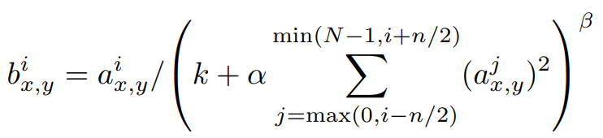

The Model continued
Half of the kernels (or neurons) on each of 2 GPUs due to GPU memory constraints.
Local Response Normalization
Overlapping Max Pooling

Slide 8
Reducing Overfitting
Data Augmentation:
Translations and horizontal reflections. Increases the training set by a factor of 2048.
Altering the intensities of the RGB (object identity is invariant to changes in the intensity and colour of the illumination).
Dropout: setting to zero the output of each hidden neuron with probability 0.5. (reduces complex co-adaptations of neurons)

Slide 9
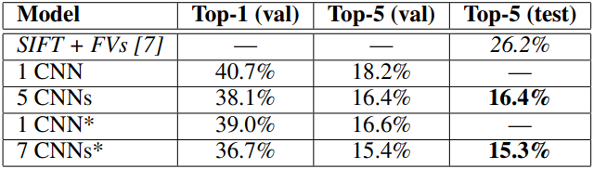
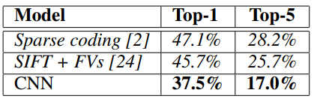
Results
ILSVRC2010 test set.
ILSVRC-2012 validation and test sets.
In italics are best results achieved by others. Models with an asterisk* were “pre-trained”.

Slide 10
Finally
Depth is important: removing any convolutional layer resulted in inferior performance.
Deep convolutional neural network is capable of achieving record-breaking results on a highly challenging dataset using purely supervised learning.
Results improve as we have made our network larger and trained it longer. Suggested improvements: faster GPUs and bigger datasets.

Slide 11
Moving on to…Visualizing and Understanding Convolutional Networks

Slide 12
Introduction
Renewed interest in convnet models since large models practical because of newly available:
Larger training sets with millions of labels.
Powerful GPU implementations.
Better regularization strategies, such as Dropout (reduce overfitting).
(Krizhevsky et al., 2012) => demonstrated that large Convolutional Network models have impressive classification performance on the ImageNet benchmark.
Need to understand why they perform so well, or how they might be improved.
Deconvolutional Network (deconvnet) to project feature activations back to the input pixel space.

Slide 13
Paper contributions
Novel visualization technique that gives insight into the function of intermediate feature layers and the operation of the classifier.
Used in a diagnostic role, visualization allow us to find model architectures that outperform Krizhevsky et al.
Provide a lot of analysis.

Slide 14
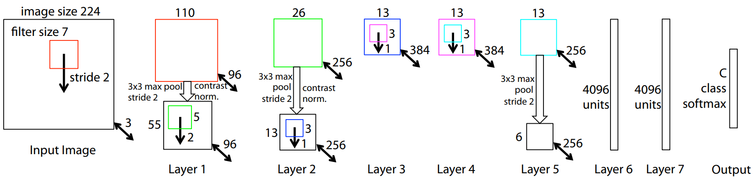
The Model
Changed from Krizhevsky et al.:
Reduced the 1st layer filter size from 11x11 to 7x7
Made the stride of the convolution 2, rather than 4.
Single GPU vs dual GPU in Krizhevsky et al.: Dense rather than sparce connections.
8-layer convnet model.
A 224 by 224 crop of an image (with 3 color planes) is presented as the input. Convolved with 96 different 1st layer filters (red), each of size 7 by 7, using a stride of 2.
Then, passed through a rectified linear function (not shown), pooled (max within 3x3 regions, using stride 2) and contrast normalized across feature maps to give 96 different 55 by 55 element feature maps.
Similar operations are repeated in layers 2,3,4,5.
The last two layers are fully connected, taking features from the top convolutional layer as input in vector form (6 · 6 · 256 = 9216 dimensions). The final layer is a C-way SoftMax function, C being the number of classes. All filters and feature maps are square in shape.

Slide 15
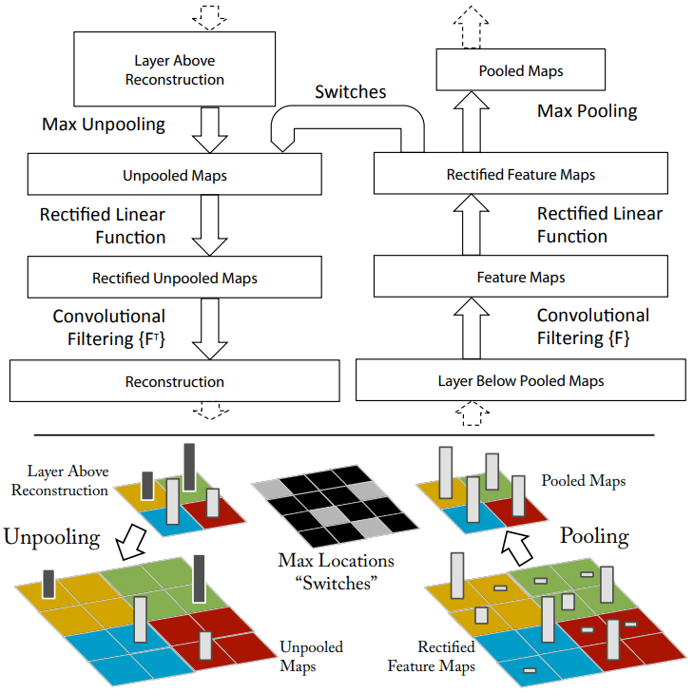
Deconvnet: Approach
Unpooling: max pooling operation is non-invertible so we need to recording the locations of the maxima (“Switches” in diagram) for an approximate inverse.
Rectification: pass through ReLU.
Filtering: transposed versions of the same filters. (flipping each filter vertically and horizontally)

Slide 16
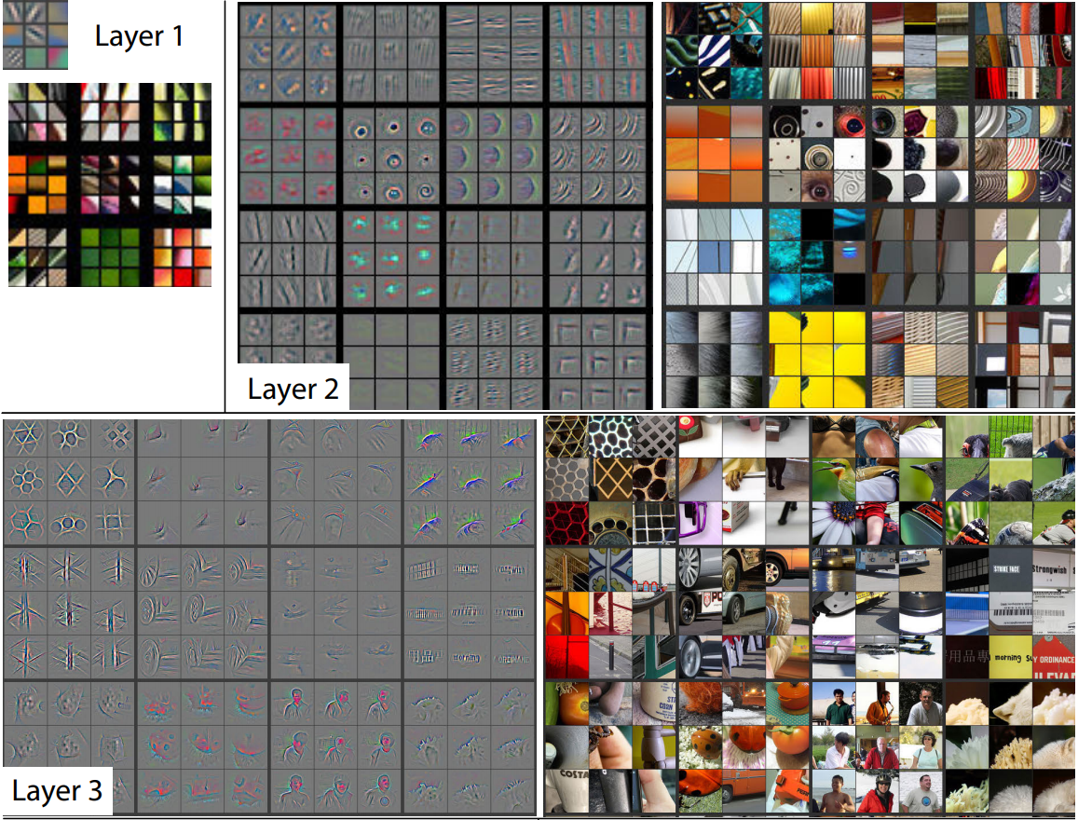
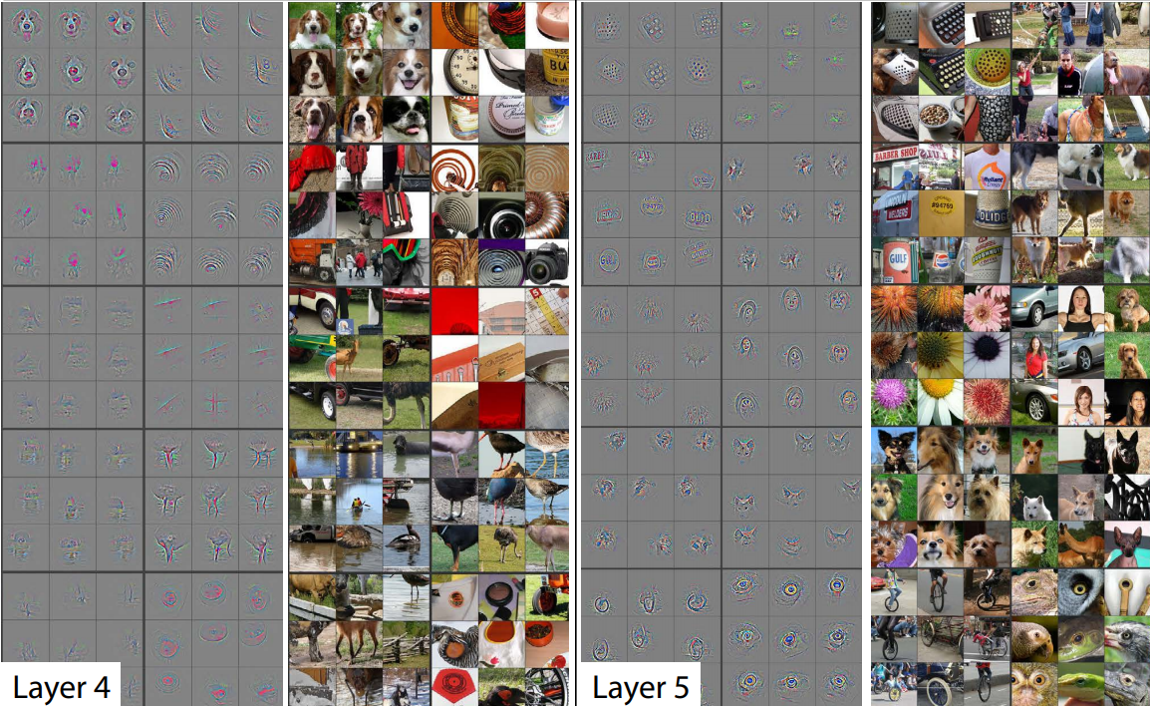
Deconvnet: Visualisations
Top 9 activations in a random subset of feature maps projected down to pixel space.
Feature map example: layer 5 r1c2 focuses on background grass.
The deeper layers find more complex features.

Slide 17
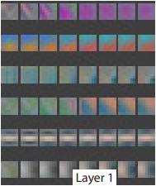
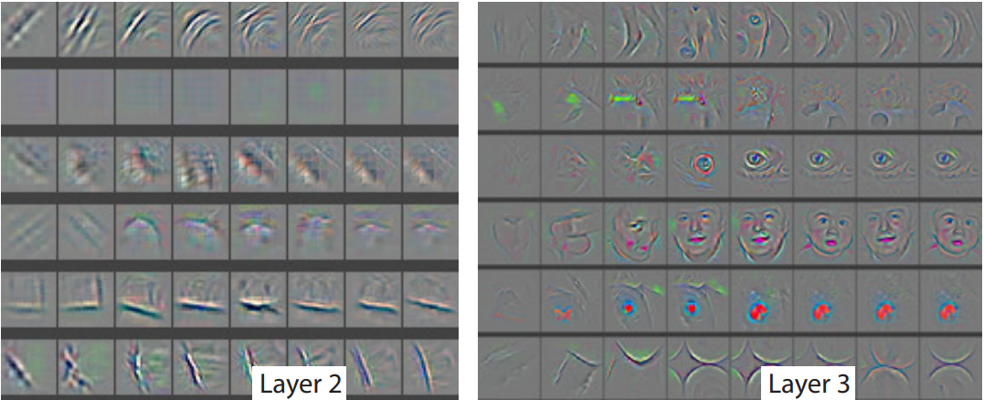
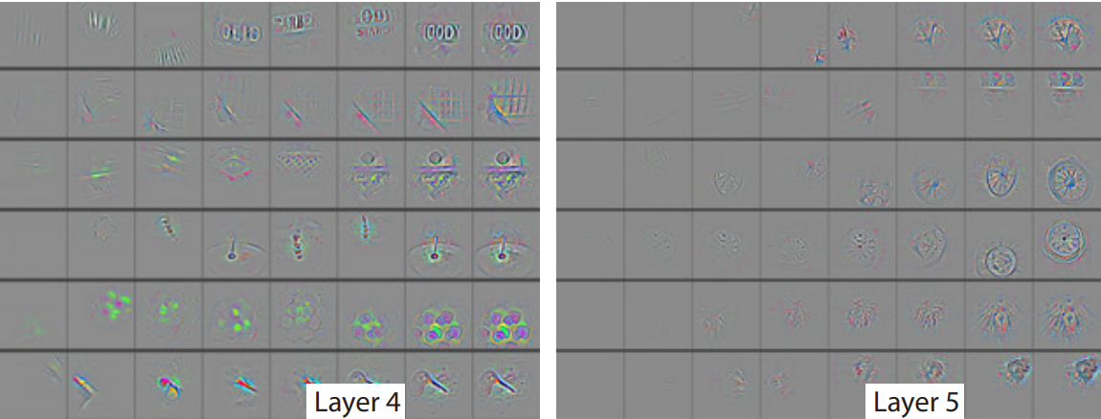
Feature Evolution during Training
Columns =
epochs [1,2,5,10,20,30,40,64]
Upper layers develop later in training (e.g., layer 5)
Its important to train enough for convergence.

Slide 18
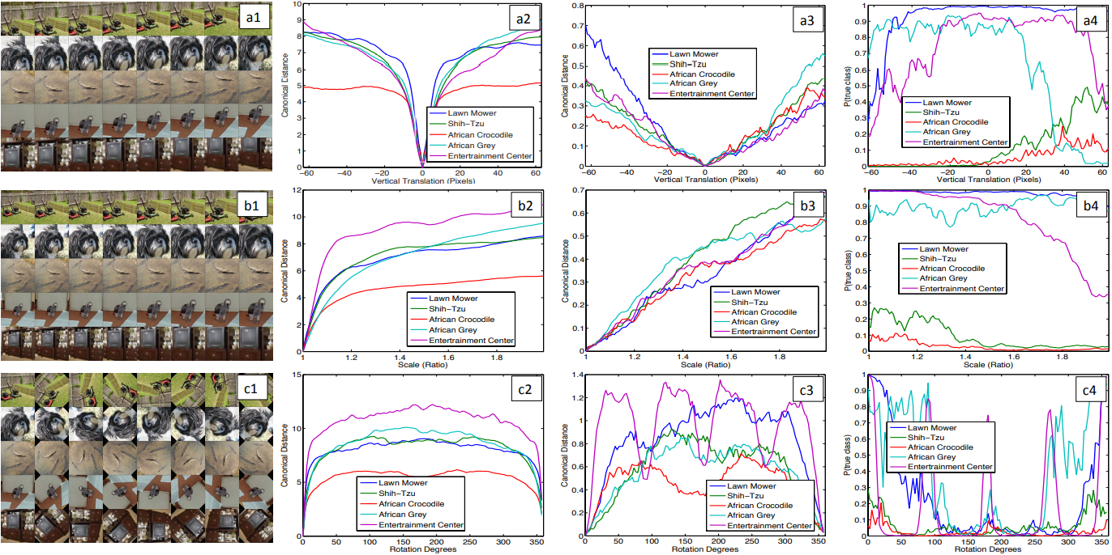
Feature Invariance
Analysis of:
Vertical translation
Scale
Rotation invariance
Example images undergoing the transformations
Euclidean distance between feature vectors from the original and transformed images in:
The probability of the true label
Layer 2
(more distance)
Layer 7
(less distance)

Slide 19
Feature Invariance
Analysis of:
Vertical translation
Scale
Rotation invariance
The network output is stable to (a) translations and (b) scaling.
In general, the output is not invariant to (c) rotation, except for object with rotational symmetry.
Example images undergoing the transformations
Euclidean distance between feature vectors from the original and transformed images in:
The probability of the true label
Layer 2
(more distance)
Layer 7
(less distance)

Slide 20
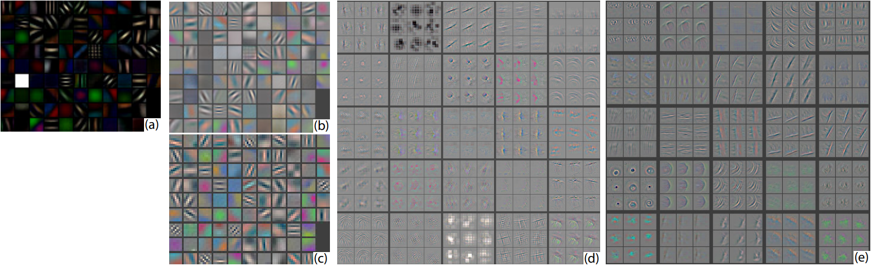
Using visualisations to improve Krizhevsky et al.
(a): 1st layer features without feature scale clipping.
(b) & (d): Krizhevsky et al.
(c) & (e): Improved
In Krizhevsky et al., the first layer filters are a mix of extremely high and low frequency information, with little coverage of the mid frequencies (b).
Additionally, the 2nd layer visualization shows aliasing artifacts caused by the large stride 4 used in the 1st layer convolutions.
Remedied by (i) reducing the 1st layer filter size from 11x11 to 7x7 and (ii) making the stride of the convolution 2, rather than 4.
The improved architecture (c&e) retain much more information in the 1st and 2nd layer features.
Importantly, improved classification performance as shown later.

Slide 21
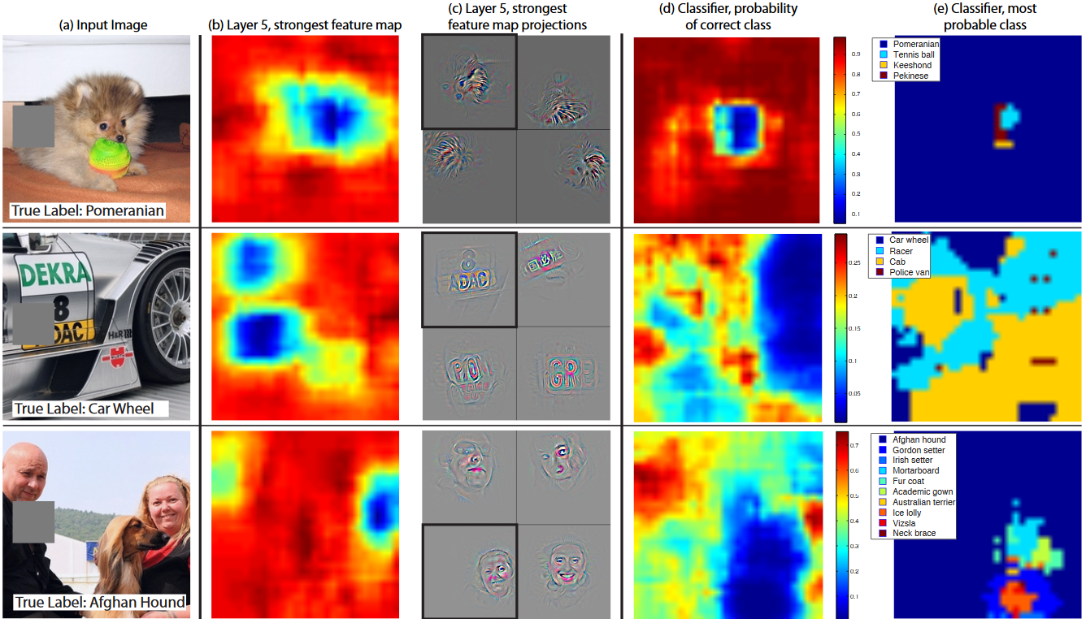
Occlusion Sensitivity
Test examples systematically covered by a grey square
The examples show the model is localising objects, as probability of the correct class drops significantly when the object is occluded.
Layer 5 feature maps ((b) & (c))
Black square = strongest activation feature’s projection.
Occlusion causes classifier probability to drop

Slide 22
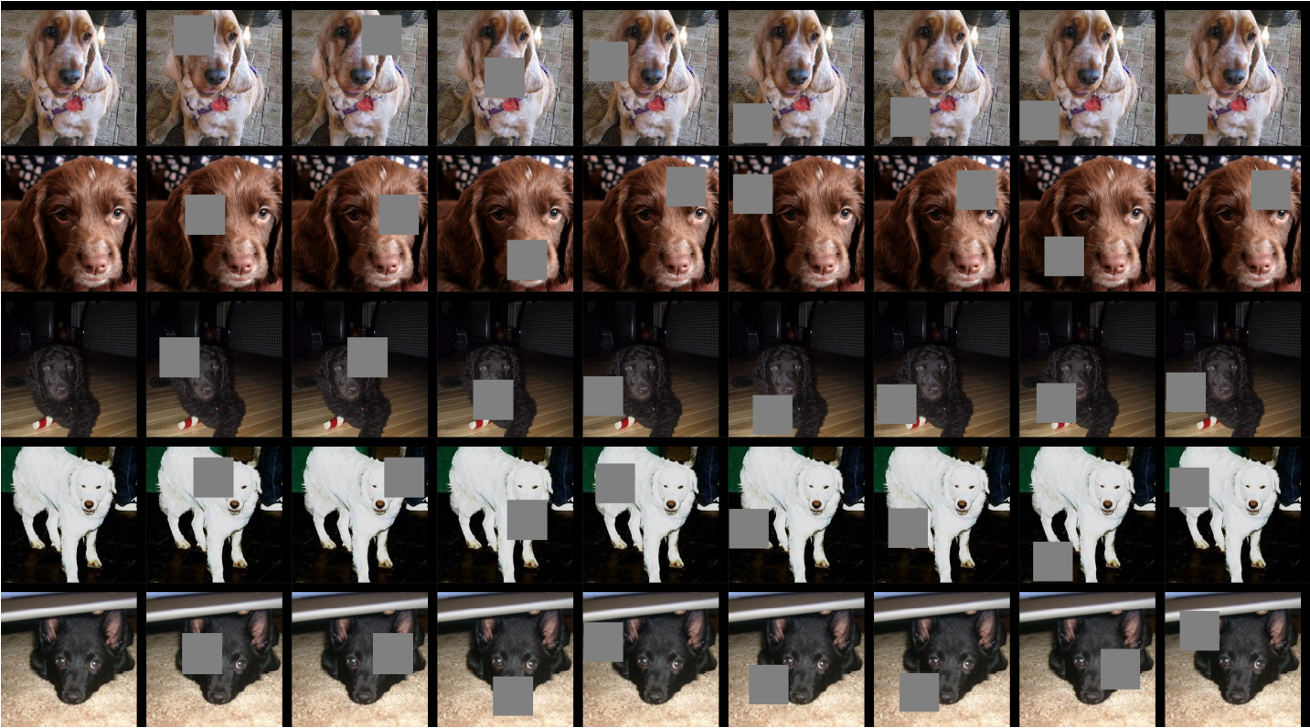
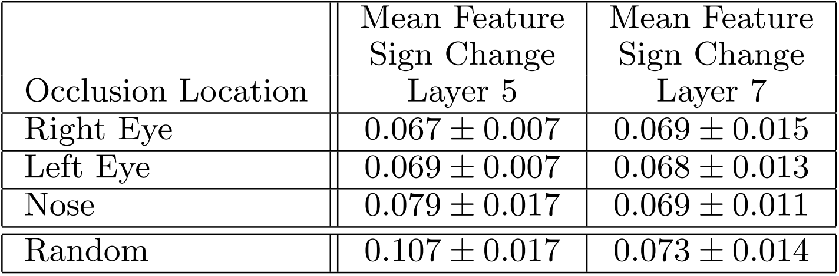
Correspondence Analysis: correspondence between specific object parts in different images (e.g. faces have a particular spatial configuration of the eyes and nose).
The lower scores for the eyes and nose (compared to random object parts) show the model implicitly establishing some form of correspondence.
At layer 7, the scores are more similar, perhaps due to upper layers trying to discriminate between the different breeds of dog.
Col 1: Original image. Col 2,3,4: Occlusion of the right eye, left eye, and nose respectively. Other columns show examples of random occlusions.

Slide 23
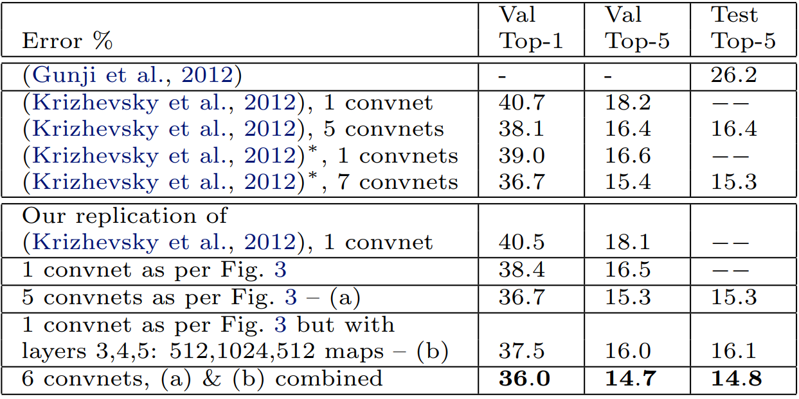
Experiments
ImageNet 2012 dataset: 1.3M/50k/100k training/validation/test examples, spread over 1000 categories.
Reproduced Krizhevskyet al., 2012 model => error rate within 0.1% of their reported value.
Improved model => better by 1.7% (test top-5).
Combine multiple models => 14.8%
This error is almost half of the top non-convnet entry in the ImageNet 2012 classification challenge, which obtained 26.2% error.

Slide 24
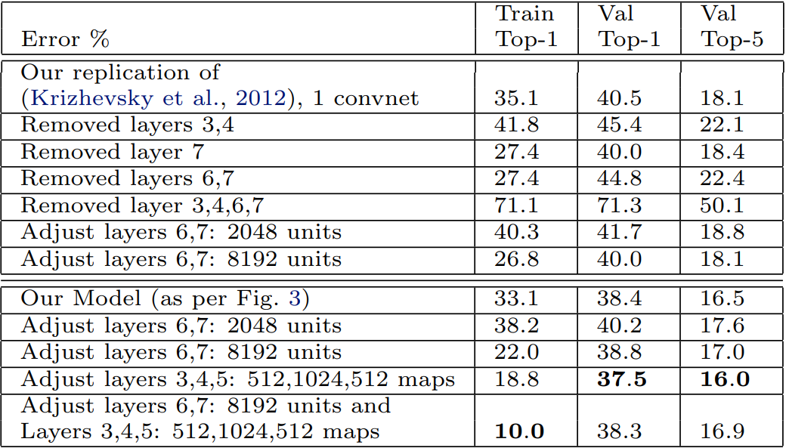
Experiments Continued…
Removing both the middle convolution layers and the fully connected layers yields a model with only 4 layers whose performance is dramatically worse.
This would suggest that the overall depth of the model is important for obtaining good performance.
Changing the size of the fully connected layers makes little difference to performance. However, increasing the size of the middle convolution layers goes give a useful gain in performance.
Increasing size of both middle convolution layers & the fully connected layers results in over-fitting.
The experiments show the importance of the convolutional part of the model in obtaining state-of-the-art performance.
Supported by the visualizations which show the complex invariances learned in the convolutional layers.

Slide 25
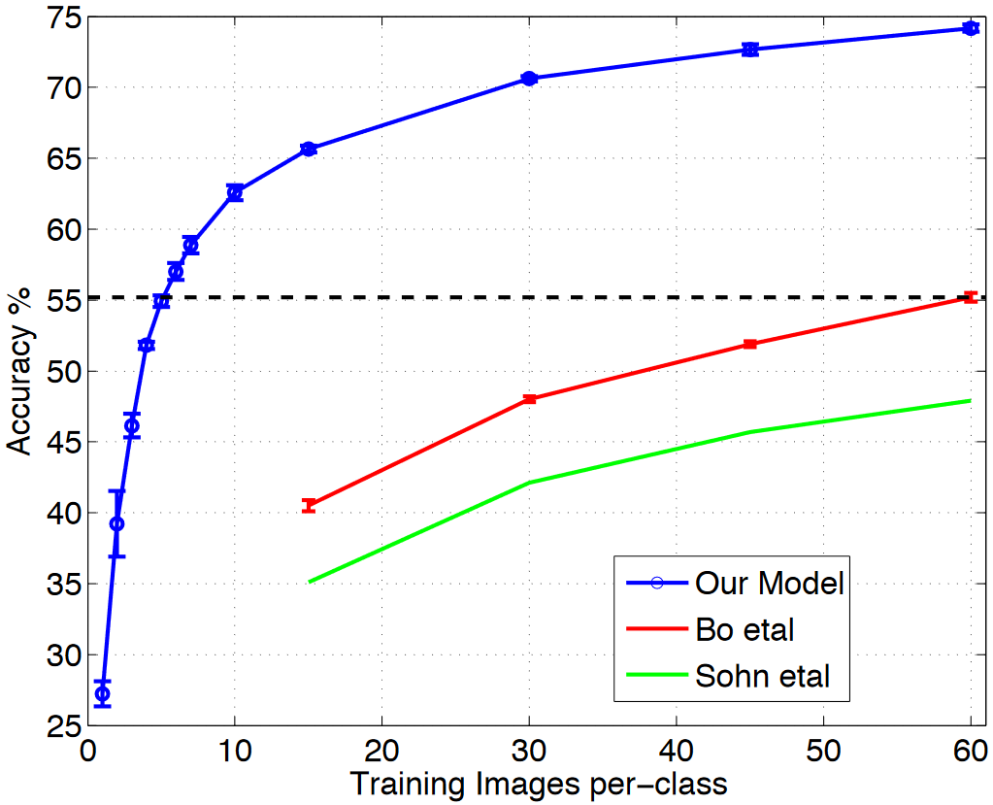
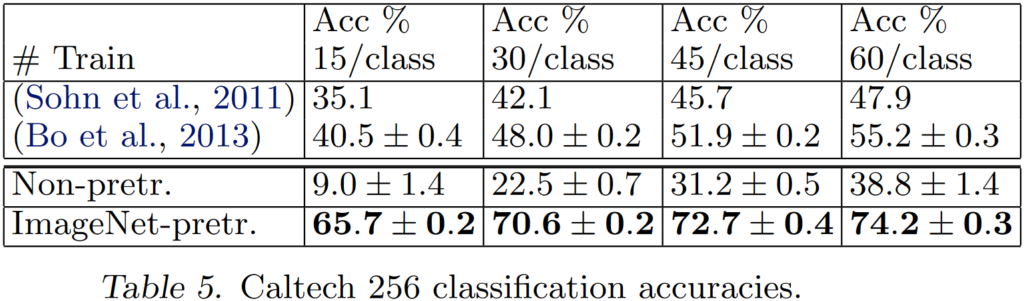
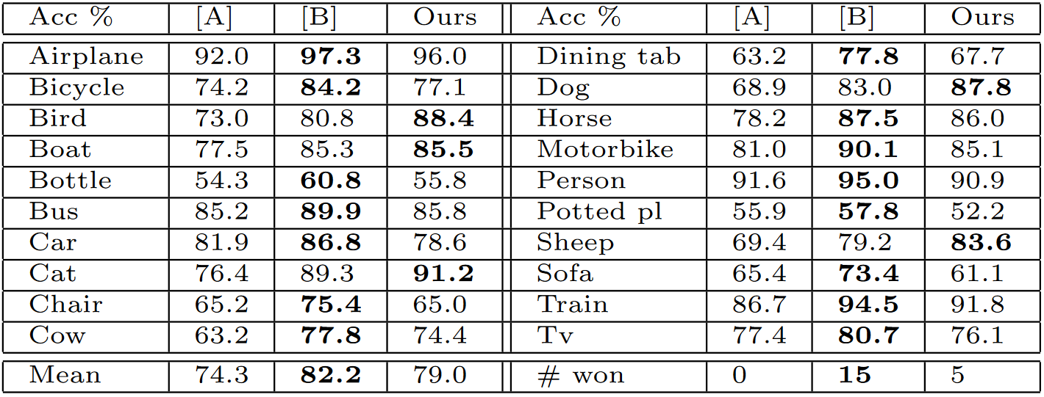
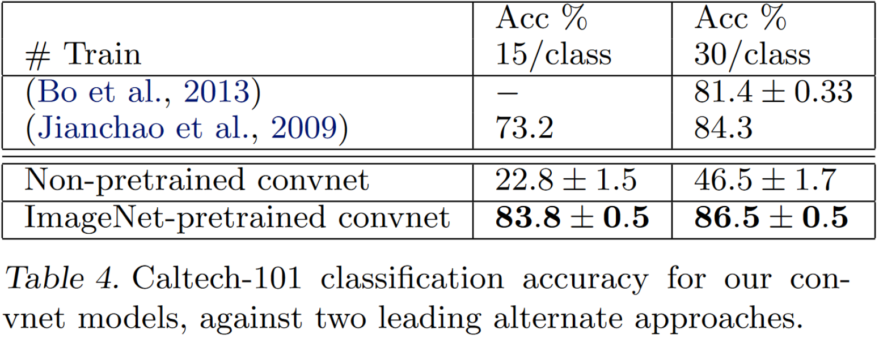
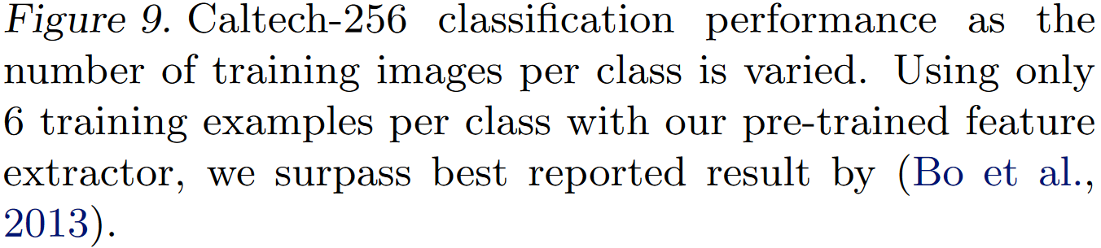
Model Transfer
PASCAL 2012 classification results, comparing our ImageNet- pretrained convnet against the leading two methods ([̶A̶]̶=̶ ̶(̶S̶a̶n̶d̶e̶ ̶e̶t̶ ̶a̶l̶.̶,̶ ̶2̶0̶1̶2̶)̶ ̶ and [B] = (Yan et al.,2012)).
Explore the ability of the feature extraction layers to generalize to other datasets, namely Caltech-101, Caltech-256 and PASCAL VOC 2012.
To do this, layers 1-7 of the ImageNet-trained model are kept fixed while a new SoftMax classifier is trained on top using the training images of the new dataset.

Slide 26
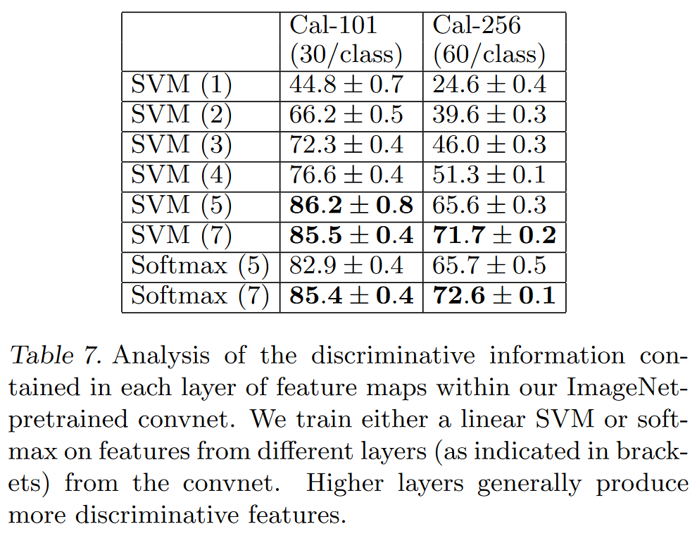
Hierarchical feature structures
This supports the premise that as the feature hierarchies become deeper, they learn increasingly powerful features.

Slide 27
Finally
Explored large convolutional neural network models, trained for image classification.
Presented novel visualisation method for activity within the model.
Visualisation reveals features are not random, they contain intuitively desirable properties such as compositionality, increasing invariance and class discrimination as we ascend the layers.
Visualisation to debug problems with a model: obtain better results.
Demonstrated through occlusions: model is highly sensitive to local structure, not just using broad scene context.
Ablation study revealed minimum depth to the network, rather than any individual section of layers.
Showed how the ImageNet trained model can generalise well to other datasets beating the best Caltech-101 and Caltech-256 reported results, in the latter case by a significant margin.
Generalized less well to the PASCAL data, but might improve with a loss function that per-mitted multiple objects per image.

